Slide 1
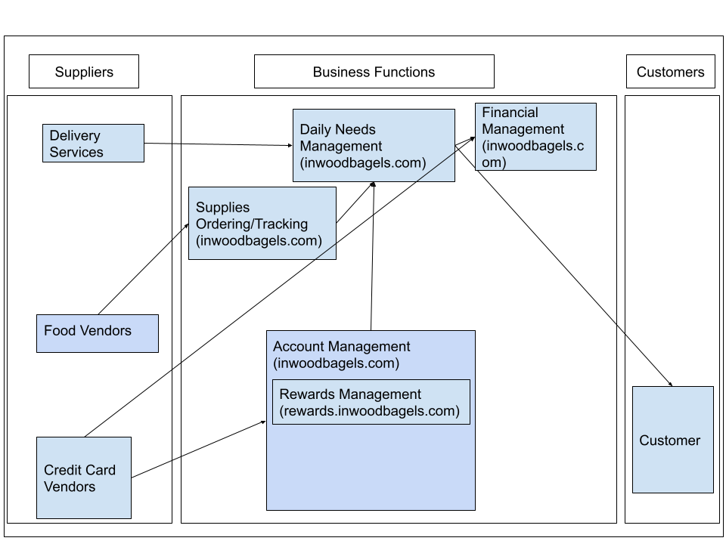
Inwood Bagels Business Relationship Map

Slide 2
User Roles by Business Group
External Users:
Customers picking up their food (Gaëlle)
Customers receiving their food by delivery (Gaëlle)
Business Group | User Roles | Team Member Name (Bus. Group Proxy)
Daily Needs Management | Day Manager | Gaëlle Gilles
Finance Management | Accountant | Noah P
Account Management | Account manager | Charlie Adams
Supplies Ordering / Tracking | Purchasing Officer | Masha Obaturova
Daily Needs Management | Delivery Driver | Gaëlle Gilles

